Slide 1
Human resources slide 1
Team 3
Katrina Witt
Charles Morgan
Mahsa Hesampour
Riona Espendido
Rates and Trends in
Cardiovascular Disease
across the United States
Of America, 1999-2019

Slide 2


Human resources slide 3
Question:
How does cardiovascular disease risk vary by ethnicity across different states across the United States of America?
Dataset:
Centers for Disease Control and Prevention

Slide 3
Human resources slide 2
This dataset documents rates and trends in heart disease and stroke mortality:
Focus: Rates and trends in heart disease and stroke mortality rates
Location: County-level estimates within the United States
Race/Ethnicity: Non-Hispanic American Indian/Alaska Native,
Non-Hispanic Asian/Pacific Islander, Non-Hispanic Black,
Hispanic, Non-Hispanic White
Timeframe: 1999-2019
Age Groups: 35-64 and 65 years and older
Sex: Women and Men

Slide 4

Human resources slide 7
Database creation process
1
2
3
4
CSV
Python
CSV
SQlite3

Slide 5



Human resources slide 5
Technology we have used for our project
SQlite3
CSV
SQLite3
HVPlot
Leaflet
Python
Leaflet
HVPlot

Slide 6
Visualisations used
Leaflet:
Audience:
Local healthcare planners & state Health Departments
Primary purpose:
Used to identify states with and without data each year
Secondary purpose:
To identify geographic trends that might indicate regional variation in:
Health care access / use
Regional differences in urban vs. rural states
Regional differences in ethnic makeup
Regional differences in lifestyle factors associated with CVD risk (e.g., impact of potential food deserts)

Slide 7
Visualisations used
Leaflet:
HVPlots:
Audience:
Local healthcare planners & state Health Departments
Primary purpose:
Used to identify states with and without data each year
Secondary purpose:
To identify geographic trends that might indicate regional variation in:
Health care access / use
Regional differences in urban vs. rural states
Regional differences in ethnic makeup
Regional differences in lifestyle factors associated with CVD risk (e.g., impact of potential food deserts)
Audience:
Local healthcare planners & state Health Departments
Primary purpose:
Used to identify states with trends that do not correlate to other states
To compare CVD rates change over time for different ethnicities
To identify ethnicities at the greatest risk of CVD
Secondary purpose:
To identify trends that might indicate variations in ethnicities
Racial predisposition towards certain CVDs

Slide 8

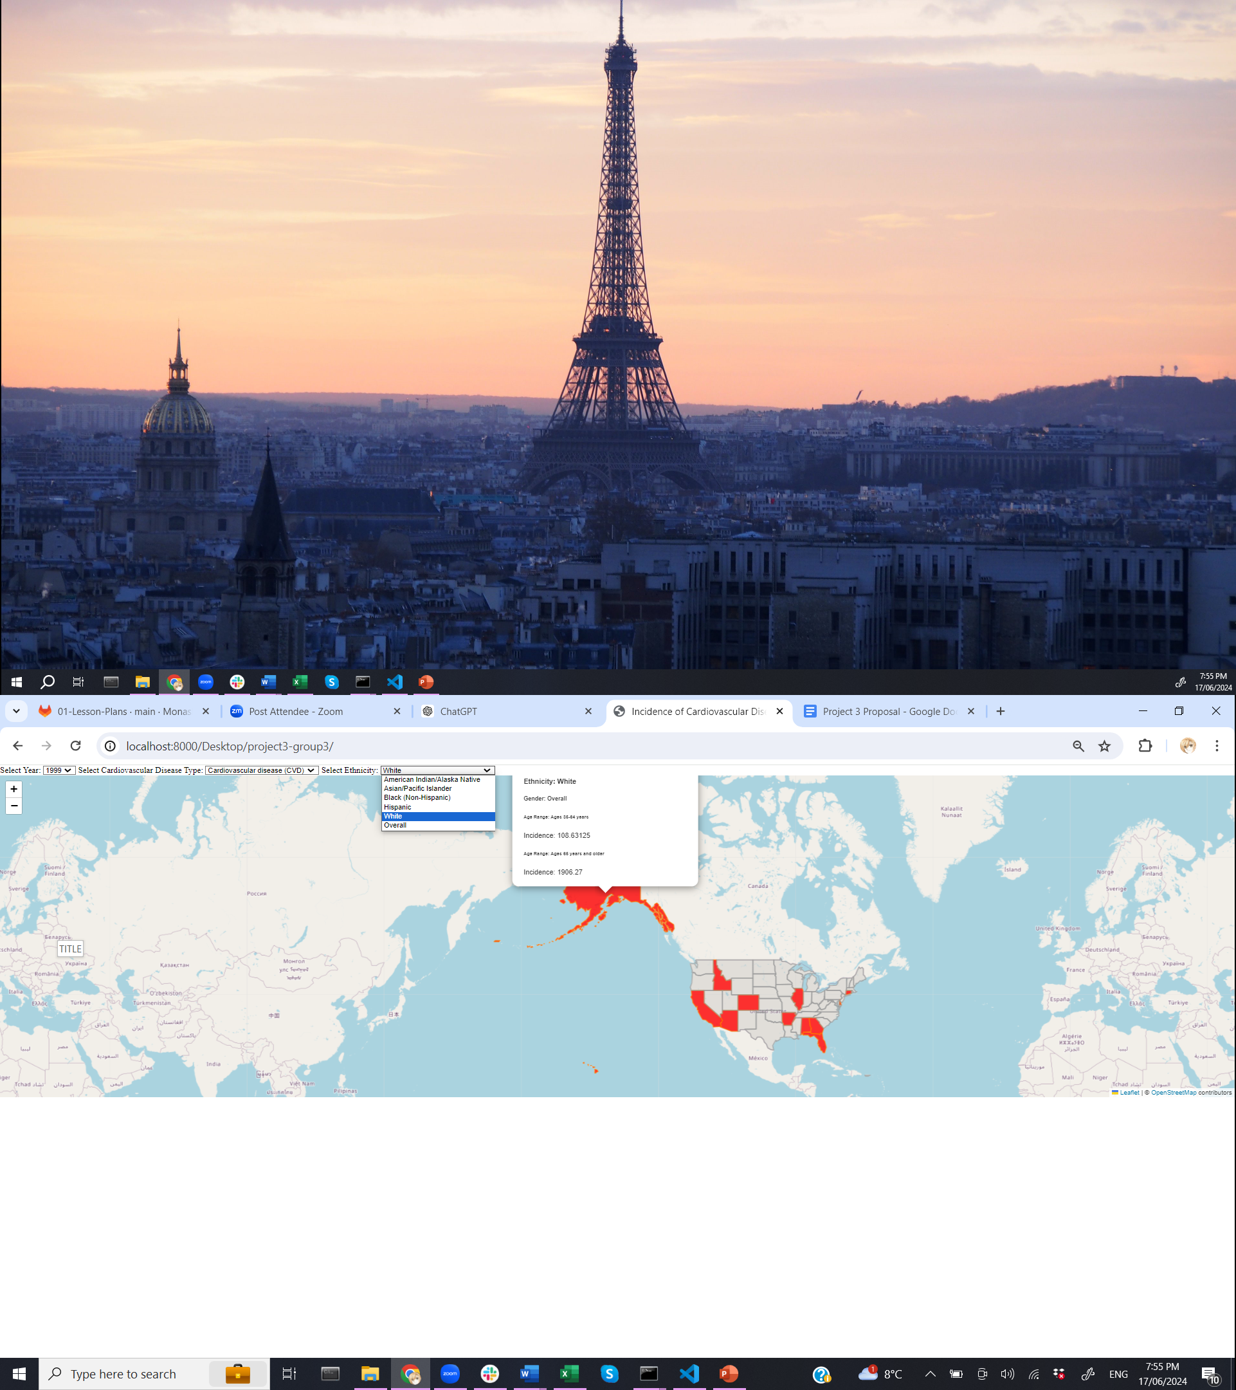
Human resources slide 9
Mapping Visualisation - Leaflet
Users can filter data based on:
Year (1999 – 2019)
Cardiovascular Disease Type:
All Cardiovascular Disease
All stroke
All heart disease
Heart failure
Coronary heart disease
Ethnicity:
American Indian / Alaska Native
Asian / Pacific Islander
Black (Non-Hispanic)
Hispanic
White
Overall

Slide 9
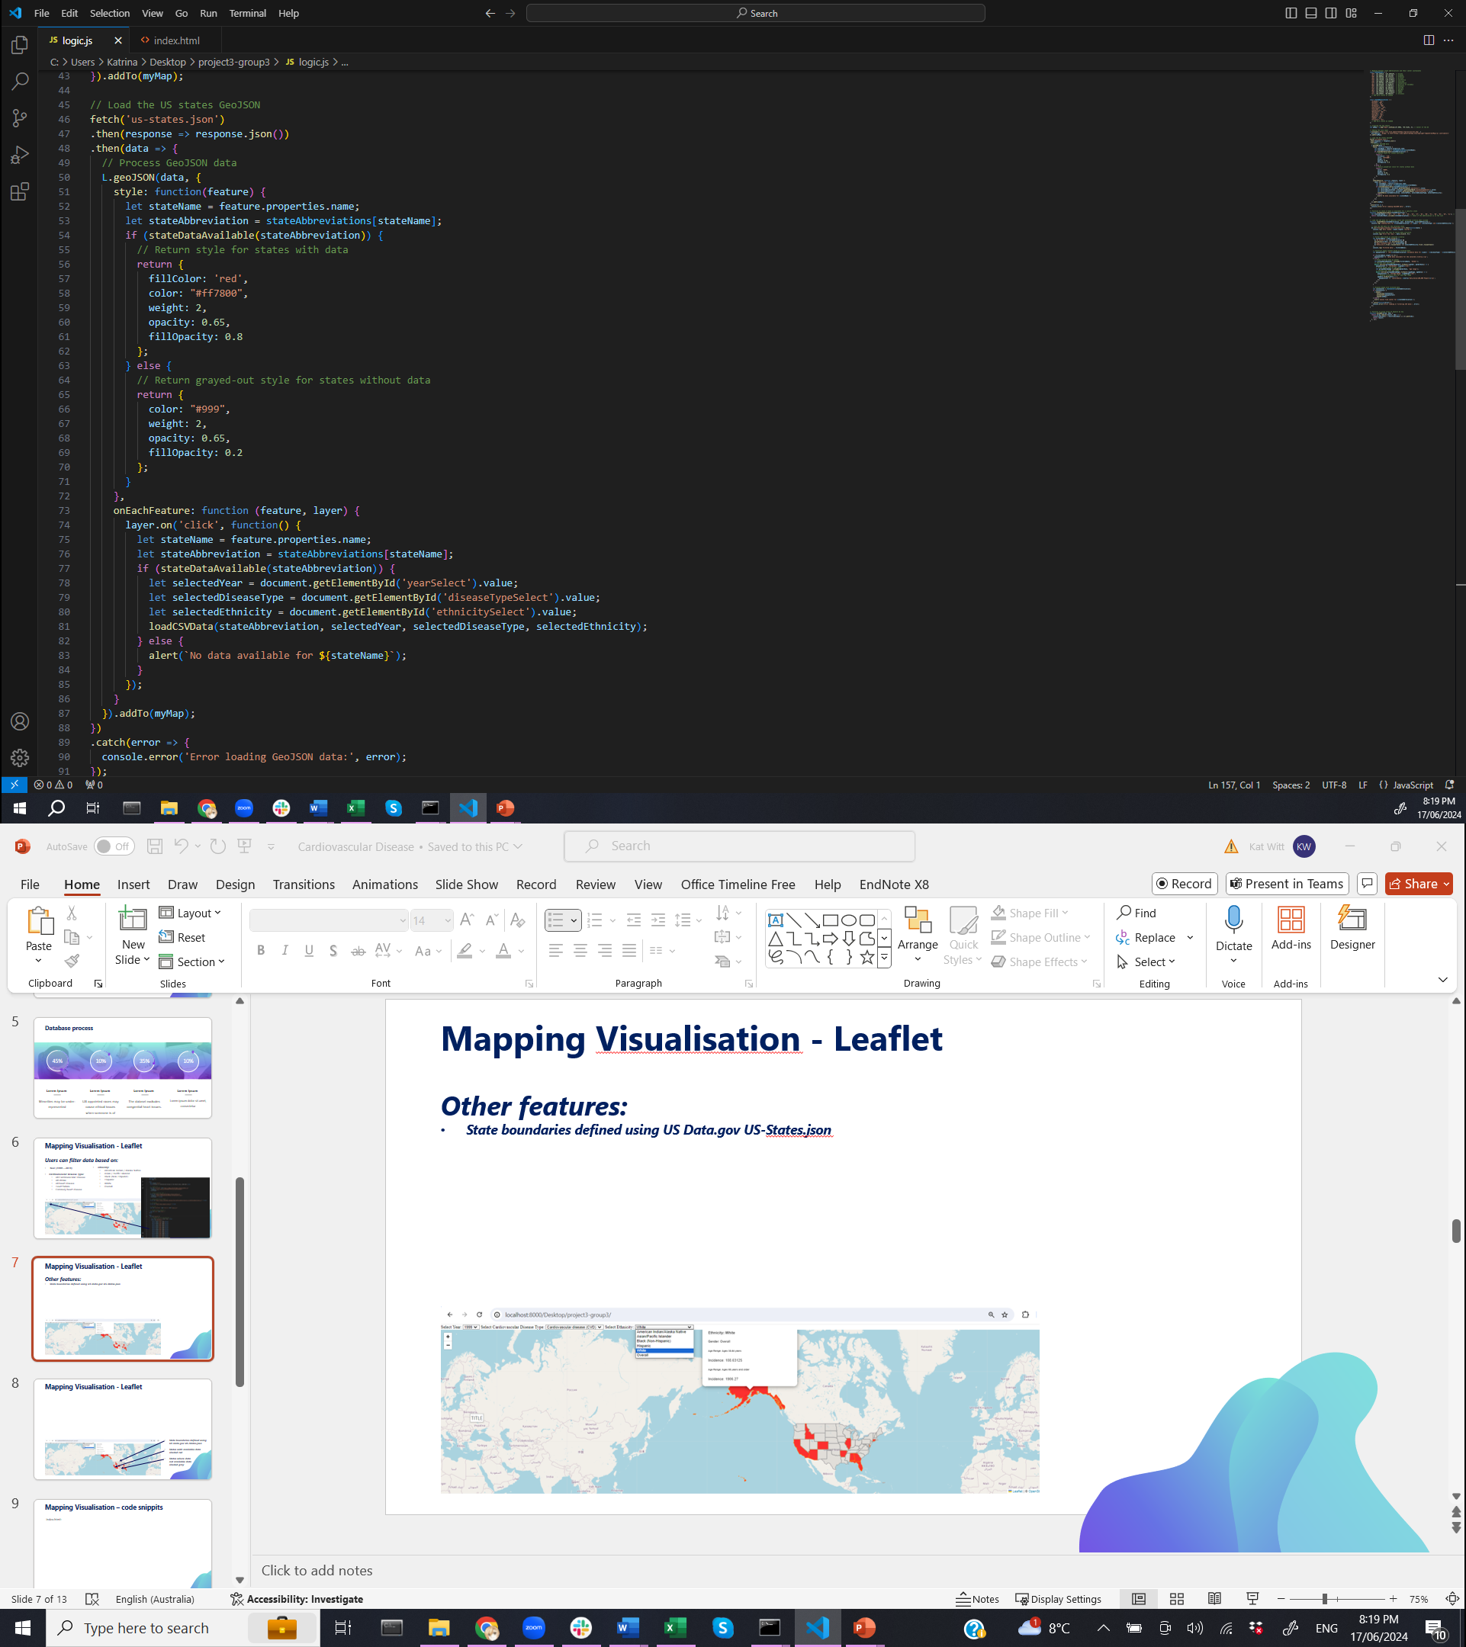
Human resources slide 9
Mapping Visualisation - Leaflet
Other features:
State boundaries defined using US Data.gov US-States.json:
Provided lat & lon, defined shape, & pop-up location
States with available data shaded red
States without data shaded gray

Slide 10
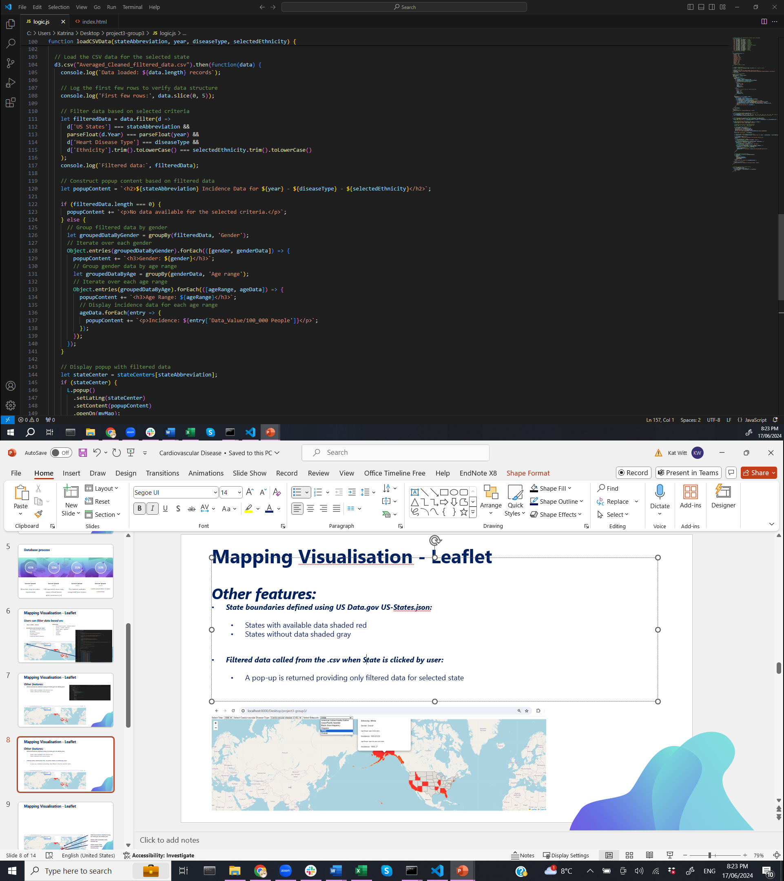
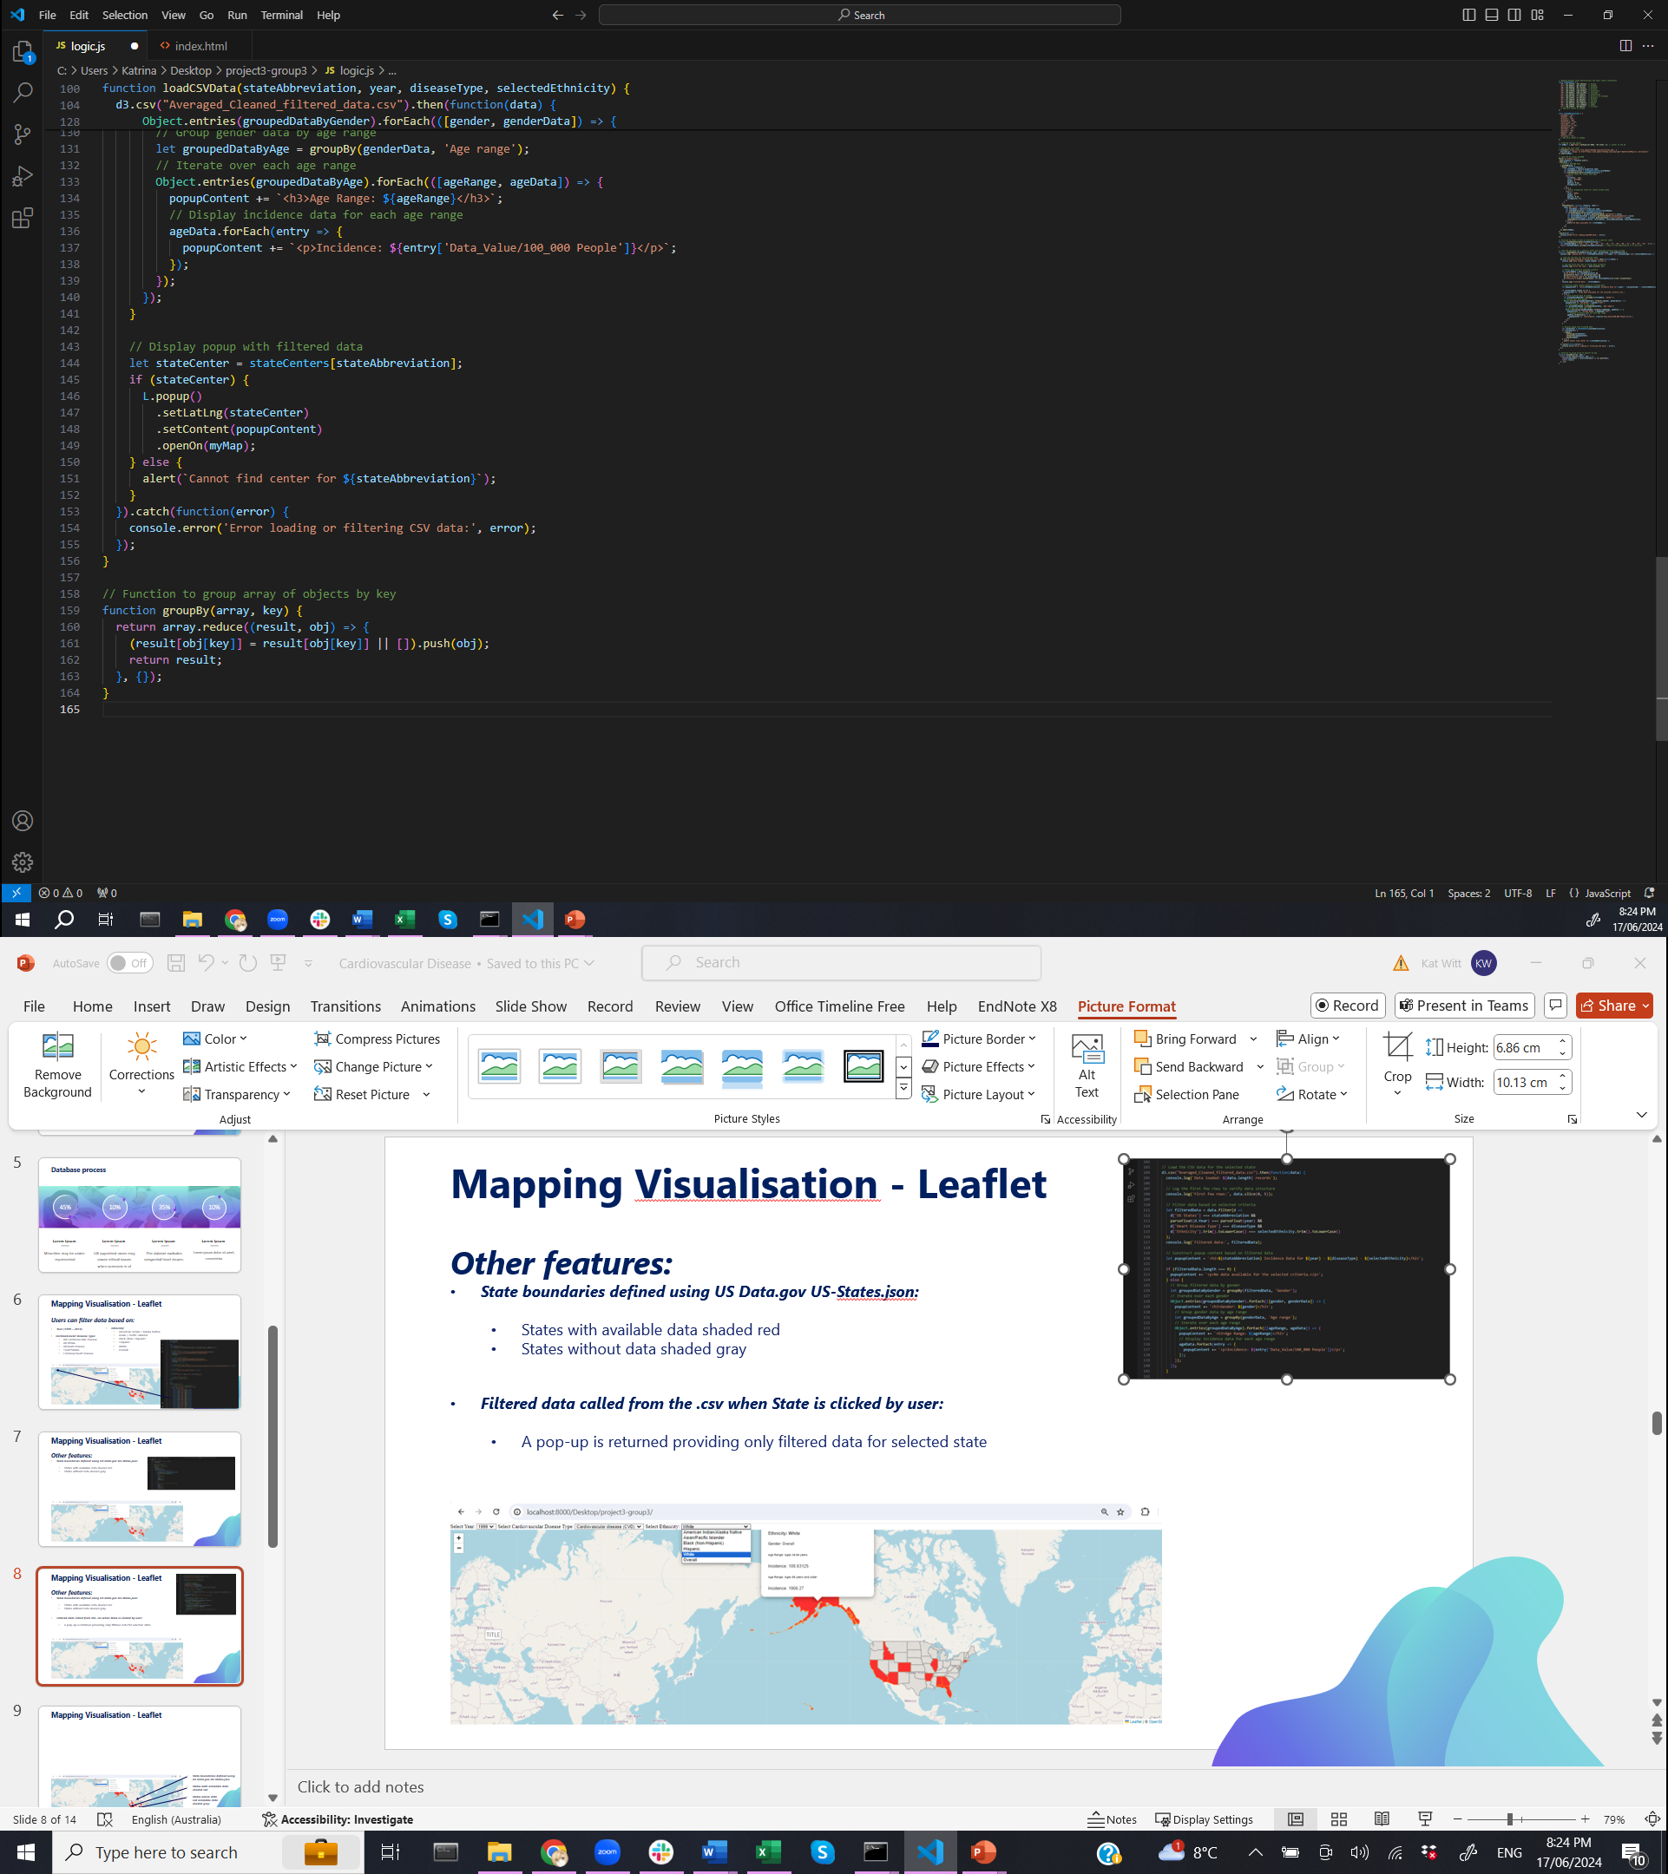
Human resources slide 9
Mapping Visualisation - Leaflet
Other features:
State boundaries defined using US Data.gov US-States.json:
Provided lat & lon, defined shape, & pop-up location
States with available data shaded red
States without data shaded gray
Filtered data called from the .csv when State is clicked by user:
A pop-up is returned providing only filtered data for selected state

Slide 11
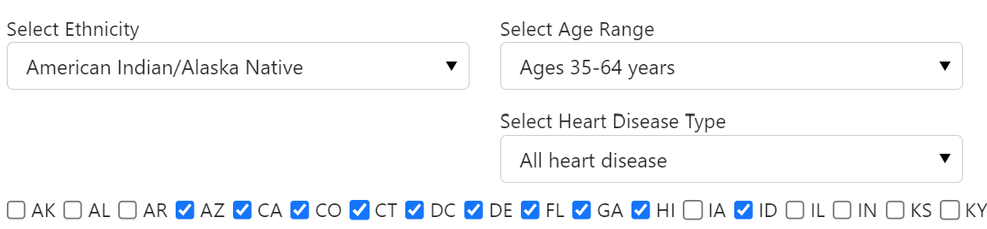
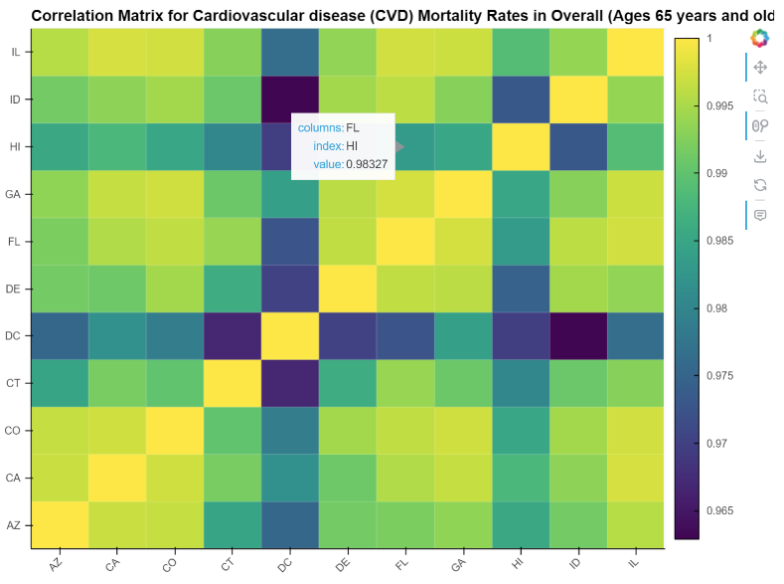
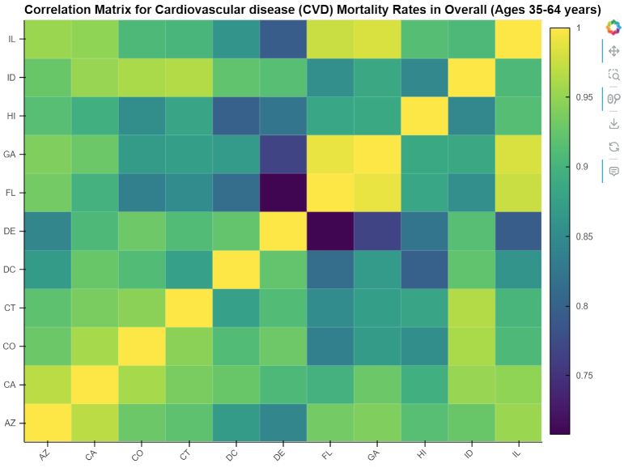
Human resources slide 9
Cardiovascular Disease Mortality Correlation Heat Map

Slide 12
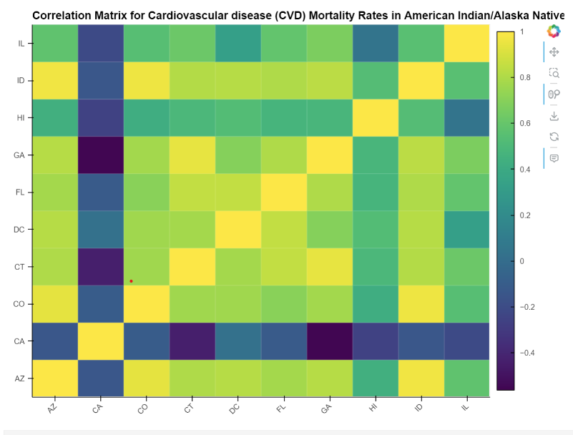
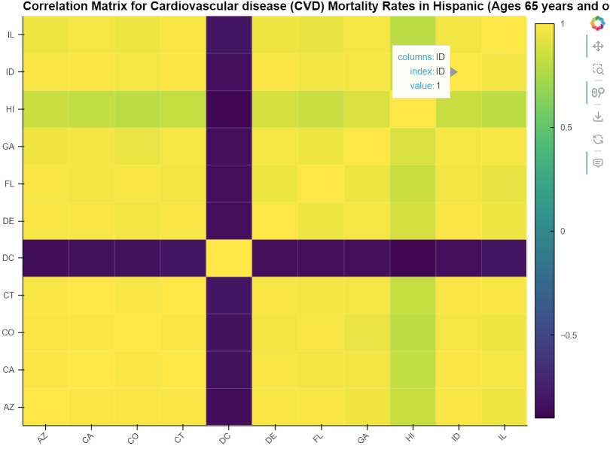
Human resources slide 9
Hispanics in Delaware (DC) show low Correlation to all other states.
Native Americans in California (CA) shows low Correlation to all other states.

Slide 13
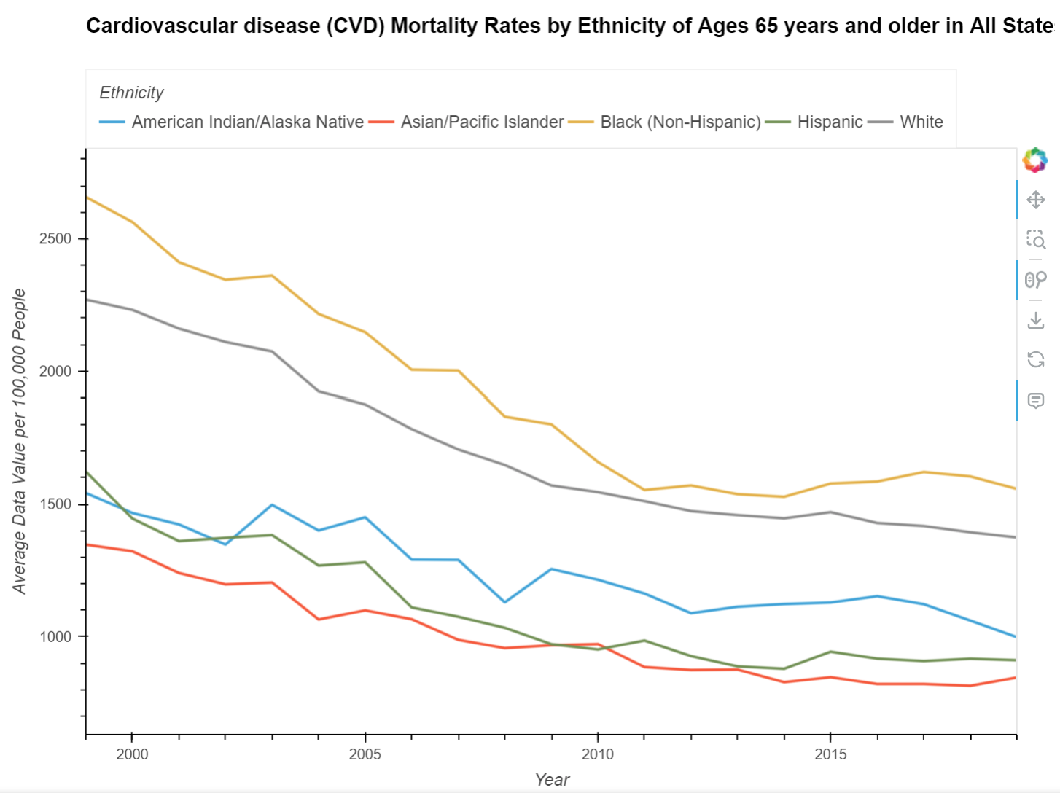
Human resources slide 9

Slide 14
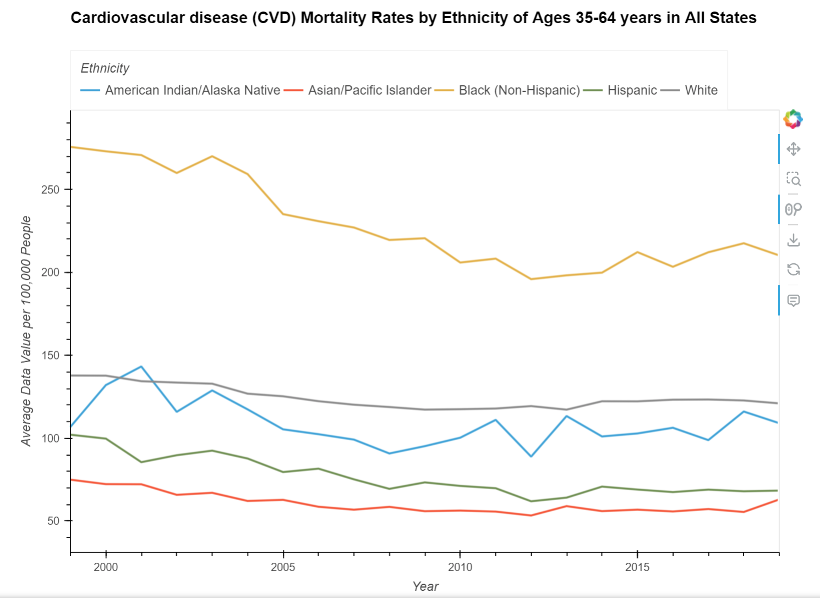

Slide 15
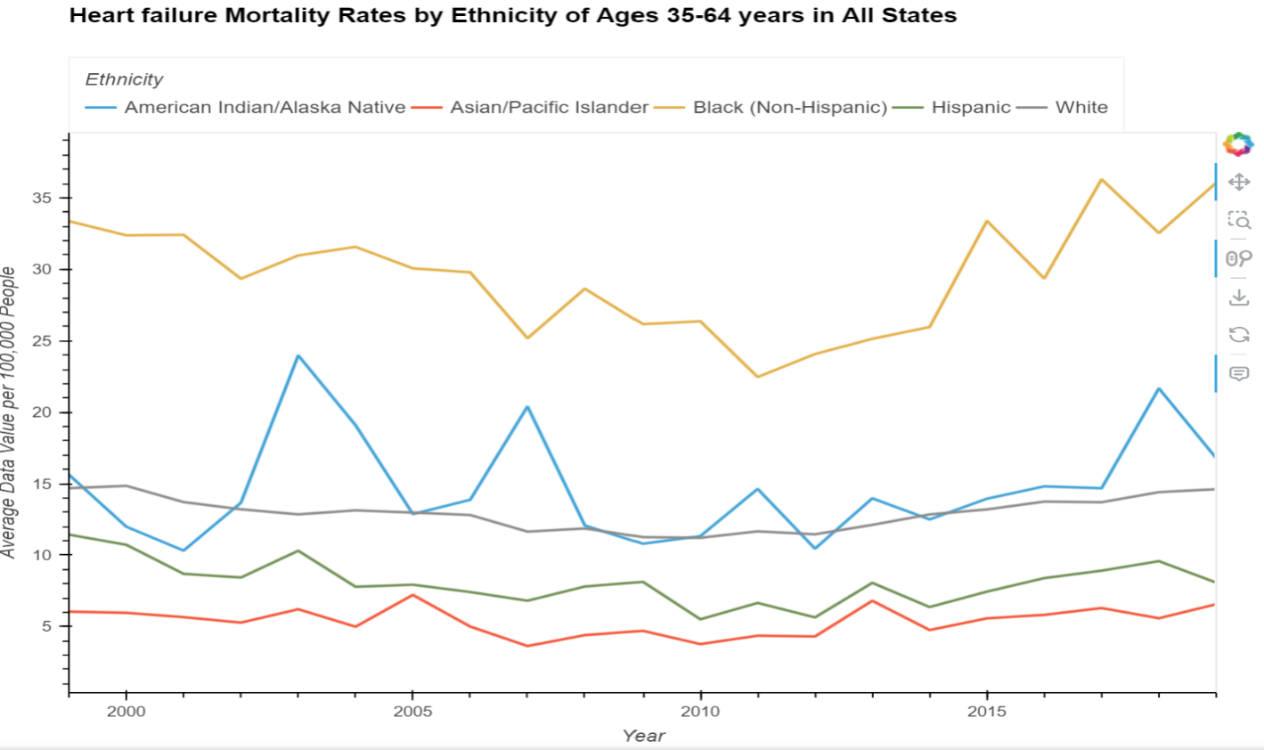

Slide 16
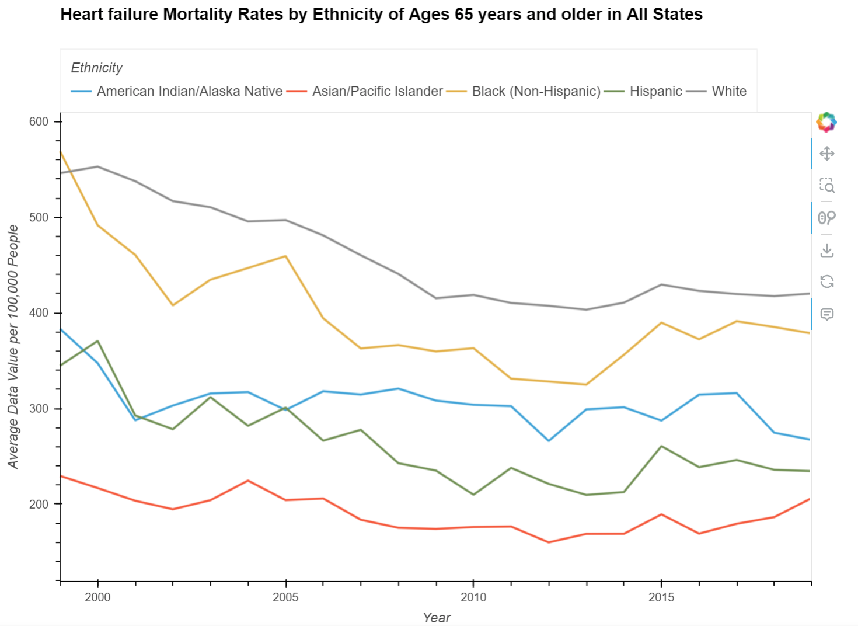

Slide 17
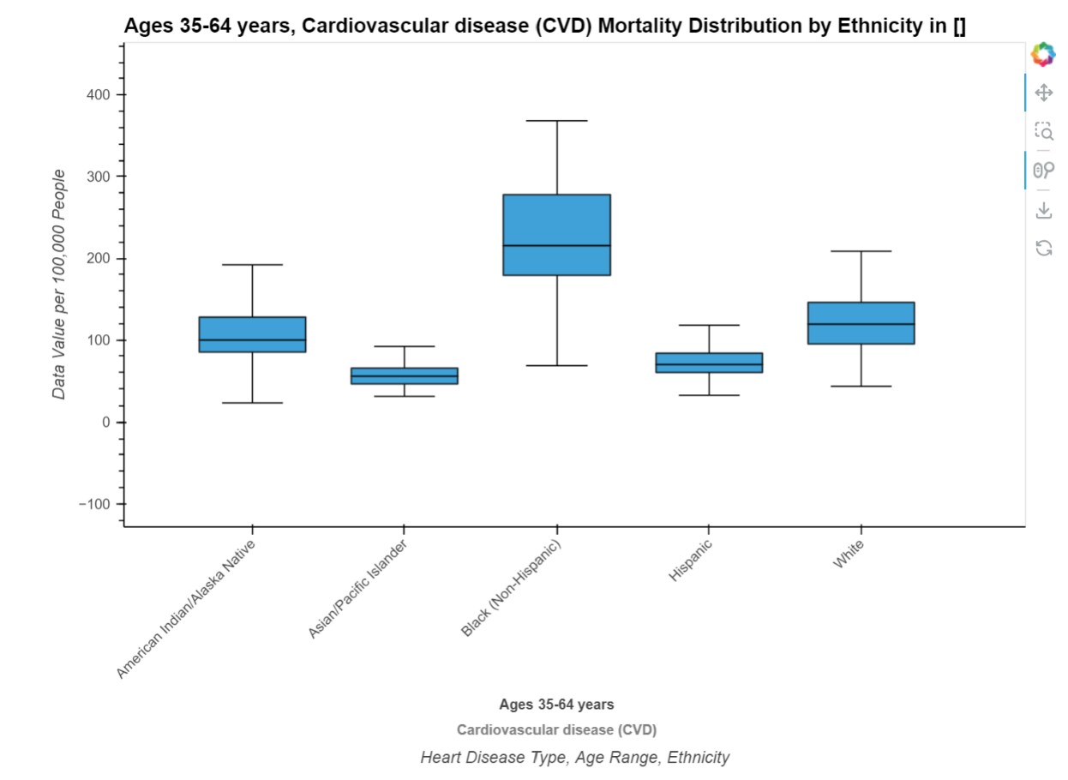
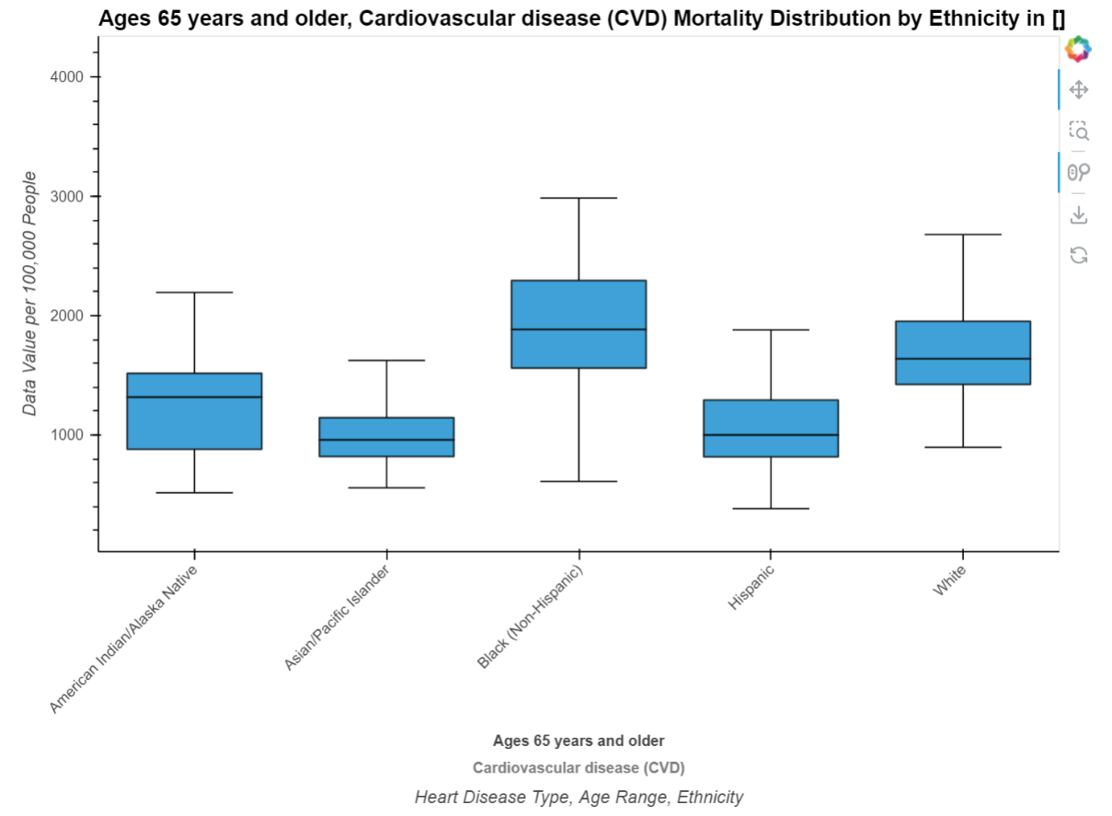
Distribution of Cardiovascular Disease Mortality rates by Ethnicity for both age groups, 35-64 years old 65 years and older

Slide 18
Human resources slide 4
What ethical implications does our data create?
The CDC has made these data available for public use to all without restriction …
…however …
Potential under-representation of minorities
Standard US race designations may not reflect mixed race individuals
Excludes congenital heart defects
Cardiovascular Disease

Slide 19

Human resources slide 8
What are the limitations?
Original .csv file size:
Original datasets very large - >52,000 entries per year
Limits further analysis of specific data, e.g., county-level
Only includes mortality end-points :
Does not give an accurate picture about survivability
Changes in health behaviors (e.g., smoking rates, diet, physical activity) over the 20 years can influence cardiovascular mortality and may vary by racial group and is not captured
Differences in awareness, diagnosis, and management of cardiovascular disease across racial groups could affect mortality trends.
Statistical challenges:
For some racial groups, particularly smaller populations, the sample size may be too small to detect significant trends or differences
Not all states or regions may have complete and consistent data over the 20-year period

Slide 20
Human resources slide 10
Demonstration

